Slide 1
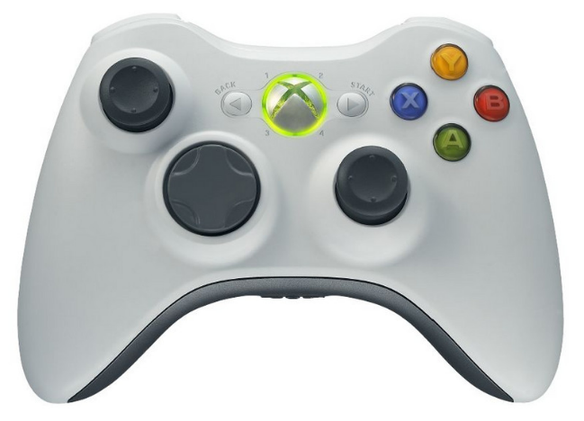

Cast Wonder
Shoot
Pause
Look
Walk
Pray/Study
LB
RB
Cast Wonder
Walk
Look
Shoot
Pray/Study
L1
R1

